Slide 1
Heritage Fair Poster Boards

Slide 2
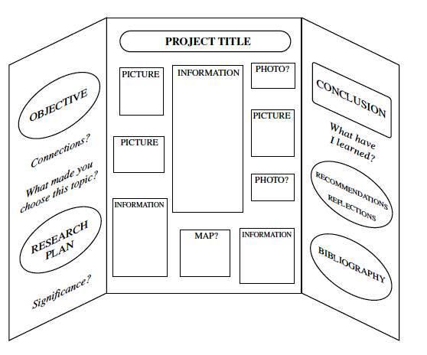

Slide 3
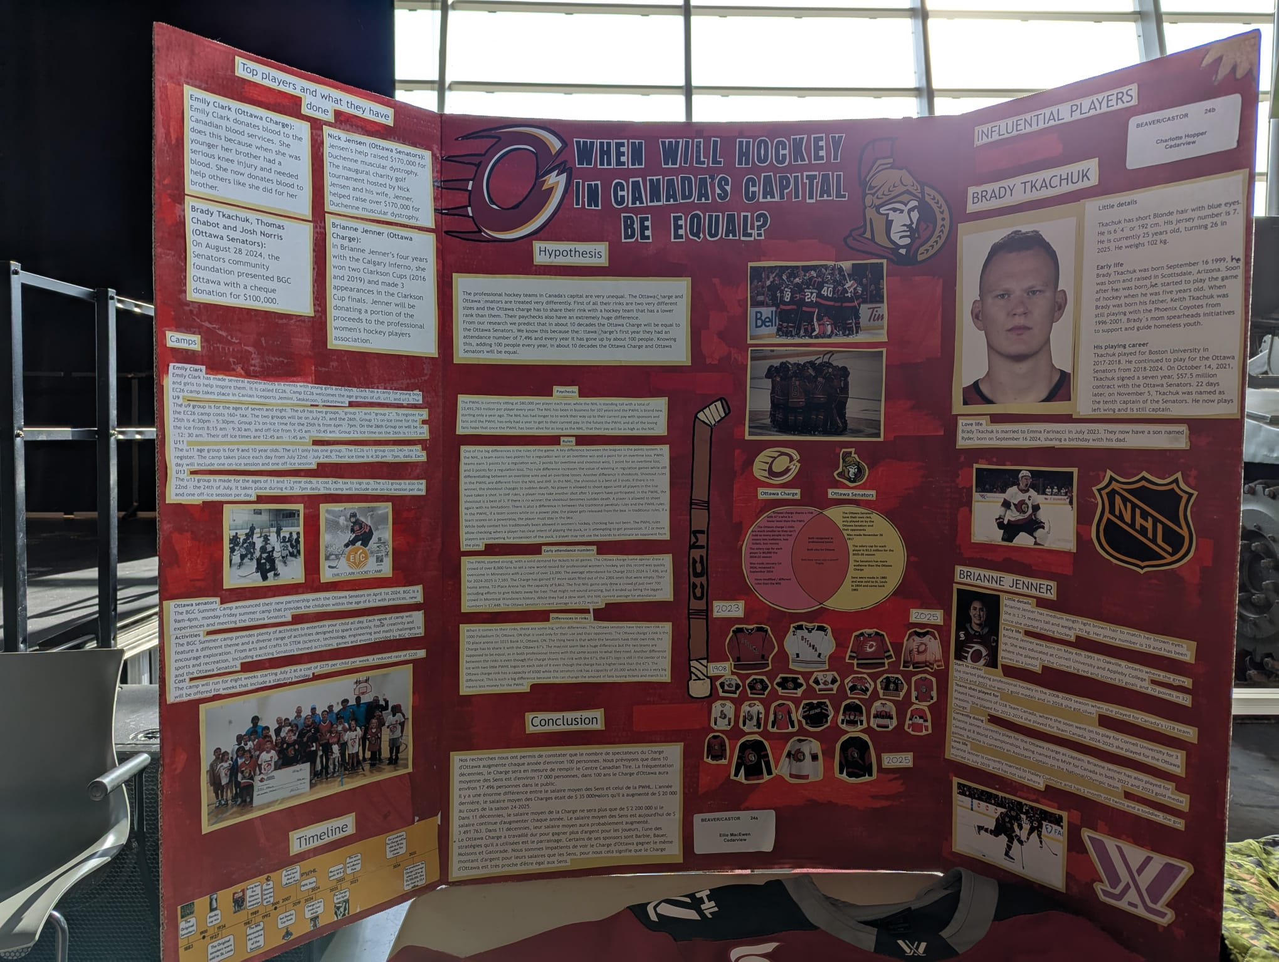

Slide 4
The Display Board
Creating an effective display board takes planning. A Heritage Fair display board is similar to those used in science fairs. It consists of three panels - one central panel and two side panels - that help organize information in a logical way.
The purpose of the display is not to host all of the information from the research paper, but the important and interesting facts that the presenter wishes to share. These will also serve as cues during the presentation for talk points with the audience.

Slide 5
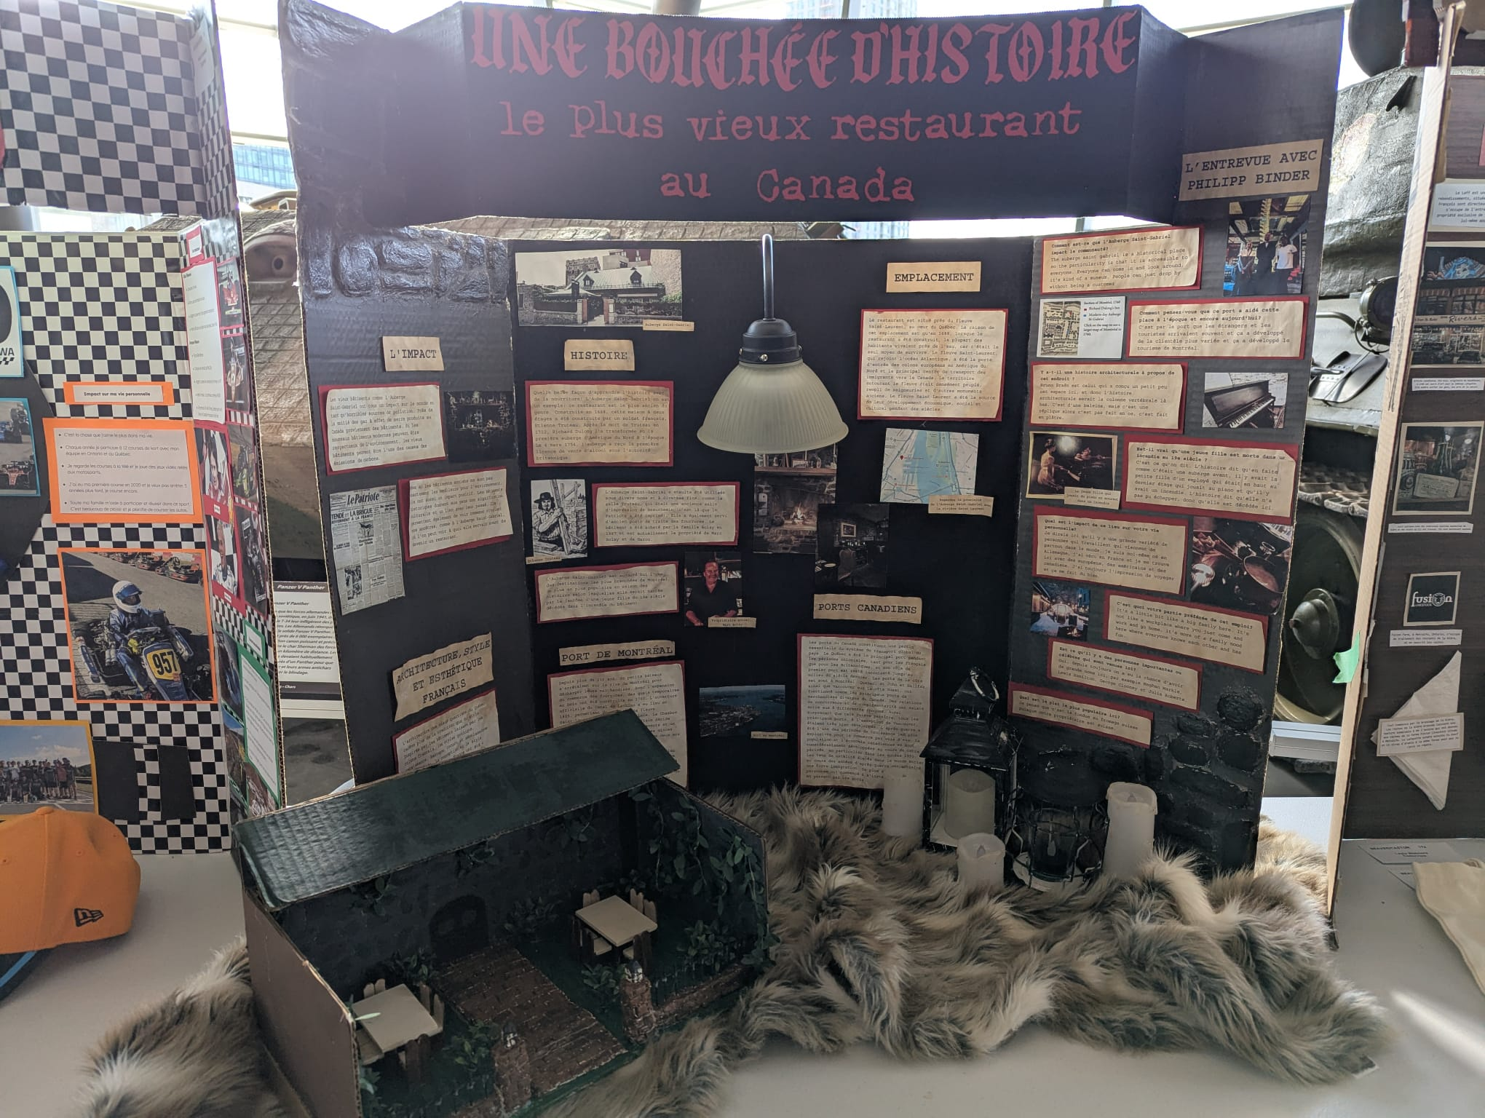

Slide 6
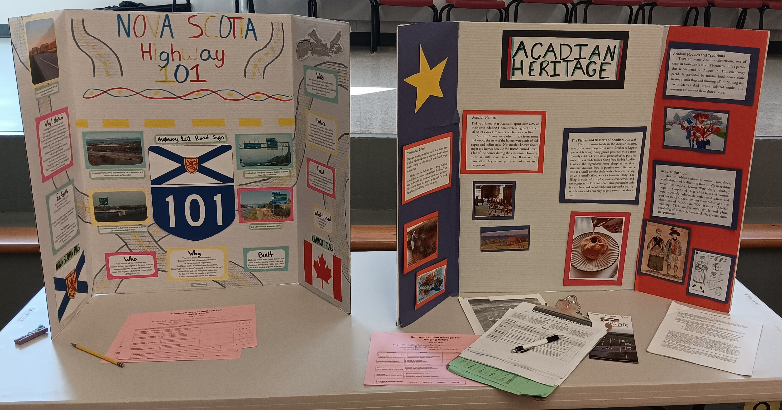

Slide 7
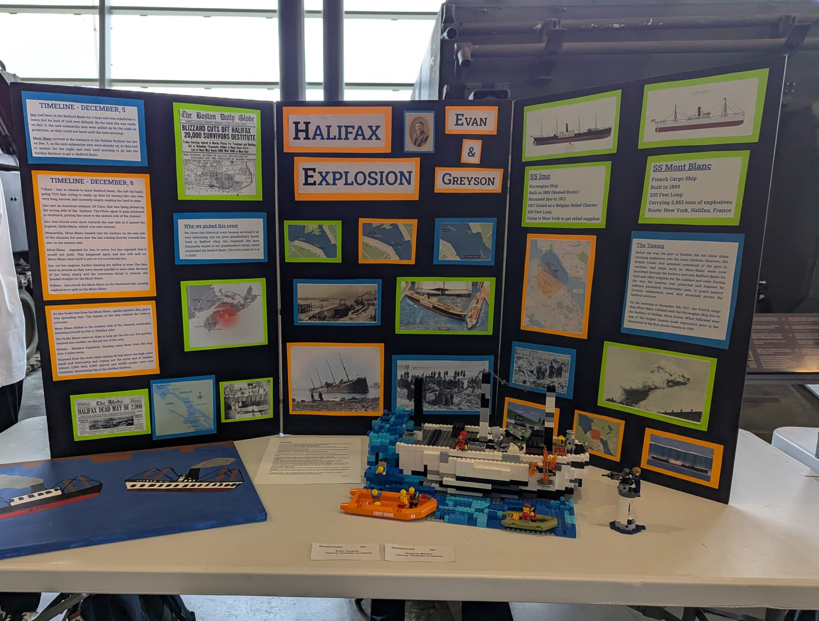

Slide 8
Choosing a Strong Title
A clear and bold title is essential. Have students consider what their title communicates to an audience. A basic title such as "The History of Maple Syrup" may not be as engaging as "How Maple Syrup Became Canada’s Sweetest Tradition." Encourage students to think creatively and consider adding a question or descriptive phrase to make their title stand out.

Slide 9
Organizing the Layout
Just like a book or a story, a display board should be structured in a way that makes it easy for viewers to follow. A tri-fold board typically consists of three panels, and a well-organized layout helps the audience absorb information more easily.

Slide 10
Middle Panel
This should be the focal point of the display. The title should be placed at the top, followed by a summary of the topic and the key research question. If possible, include a main image or map that represents the subject, such as a visual of a sugar maple tree or a map of Canada’s major syrup-producing regions.

Slide 11
Left Panel
This panel should introduce the topic with background information, historical context, and any relevant foundational knowledge, such as Indigenous

Slide 12
Right Panel
This should focus on the impact of maple syrup production, key discoveries, and personal reflections. It may also include how the topic connects to modern Canada, such as the economic importance of the maple syrup industry today.

Slide 13
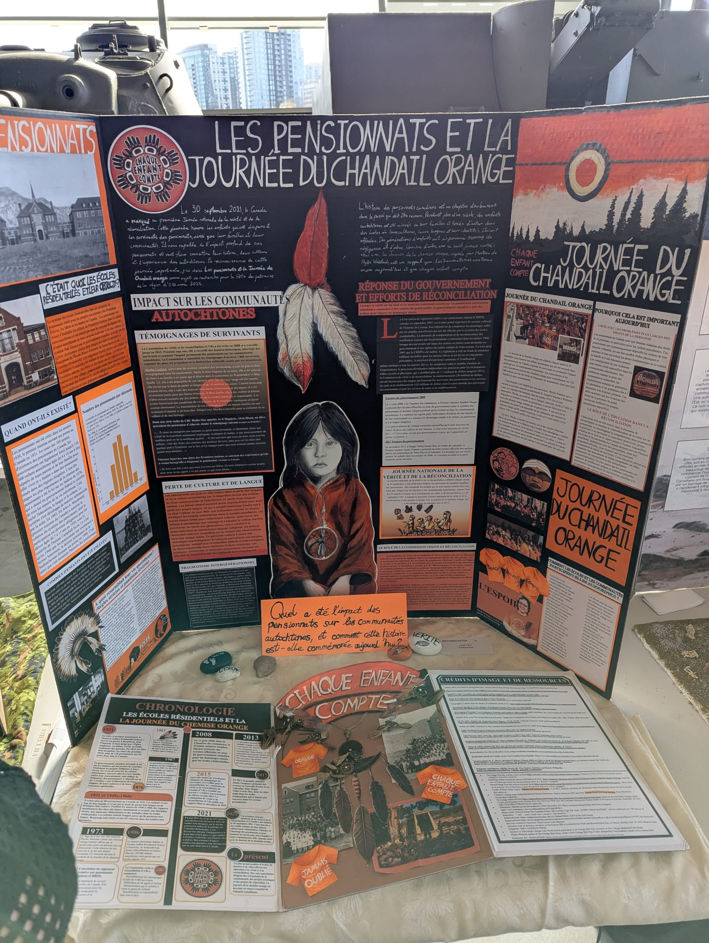
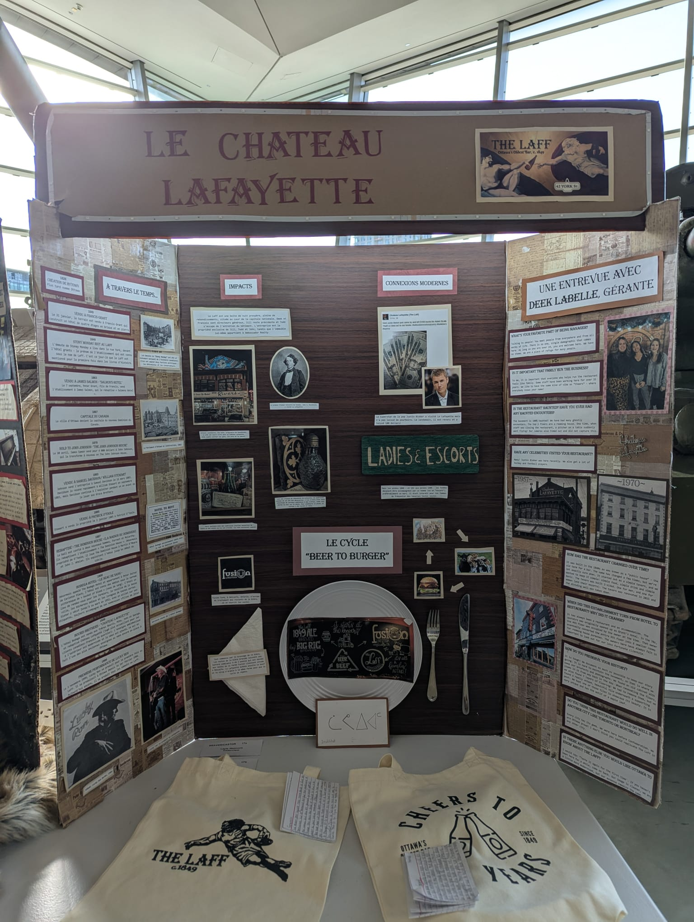

Slide 14
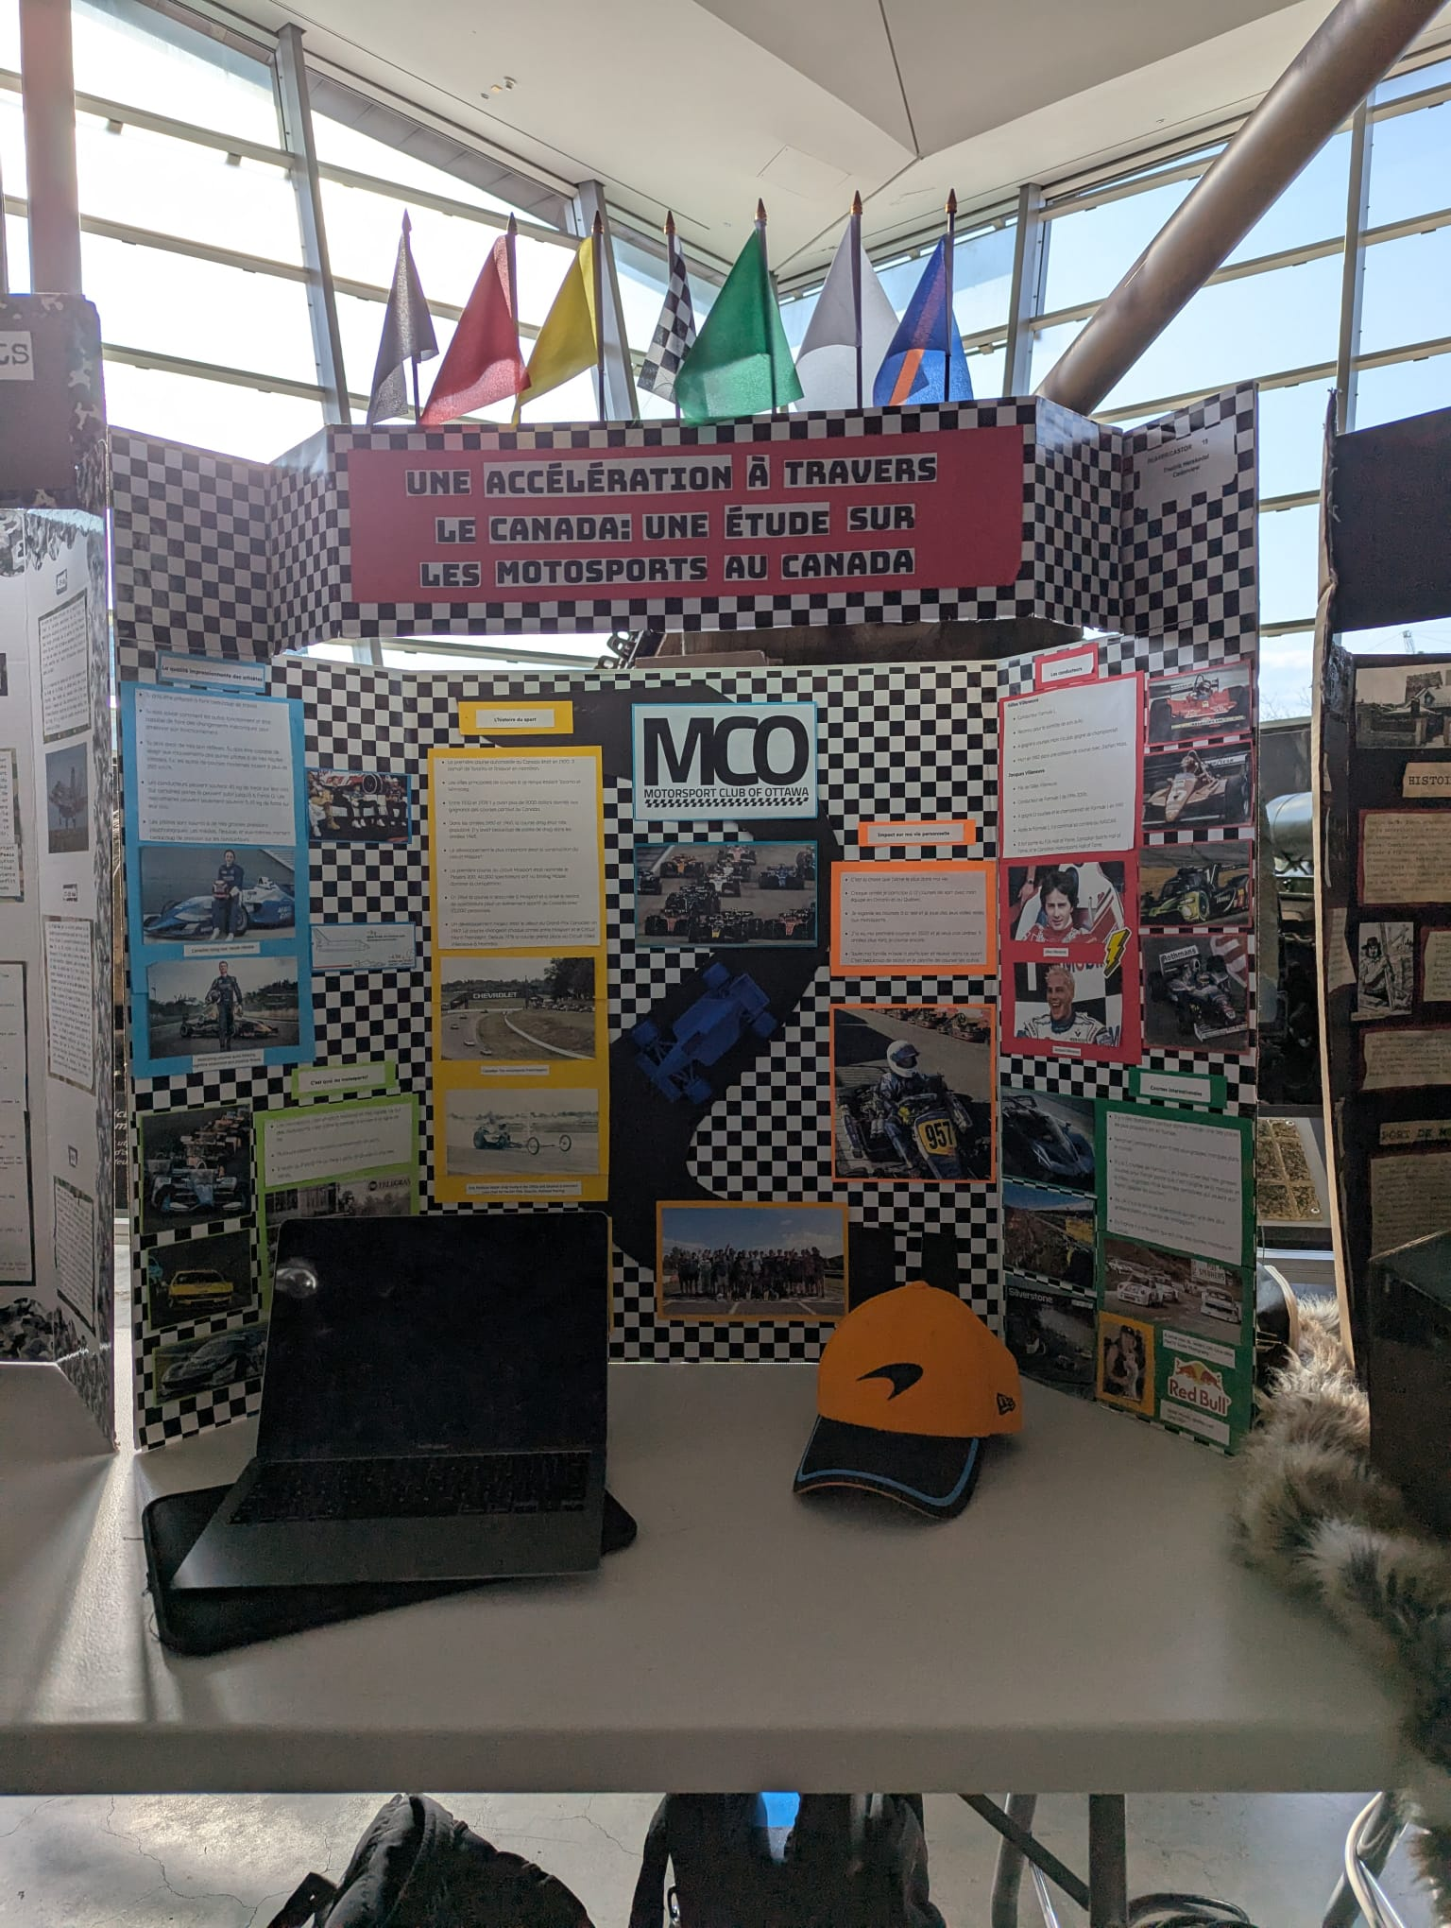
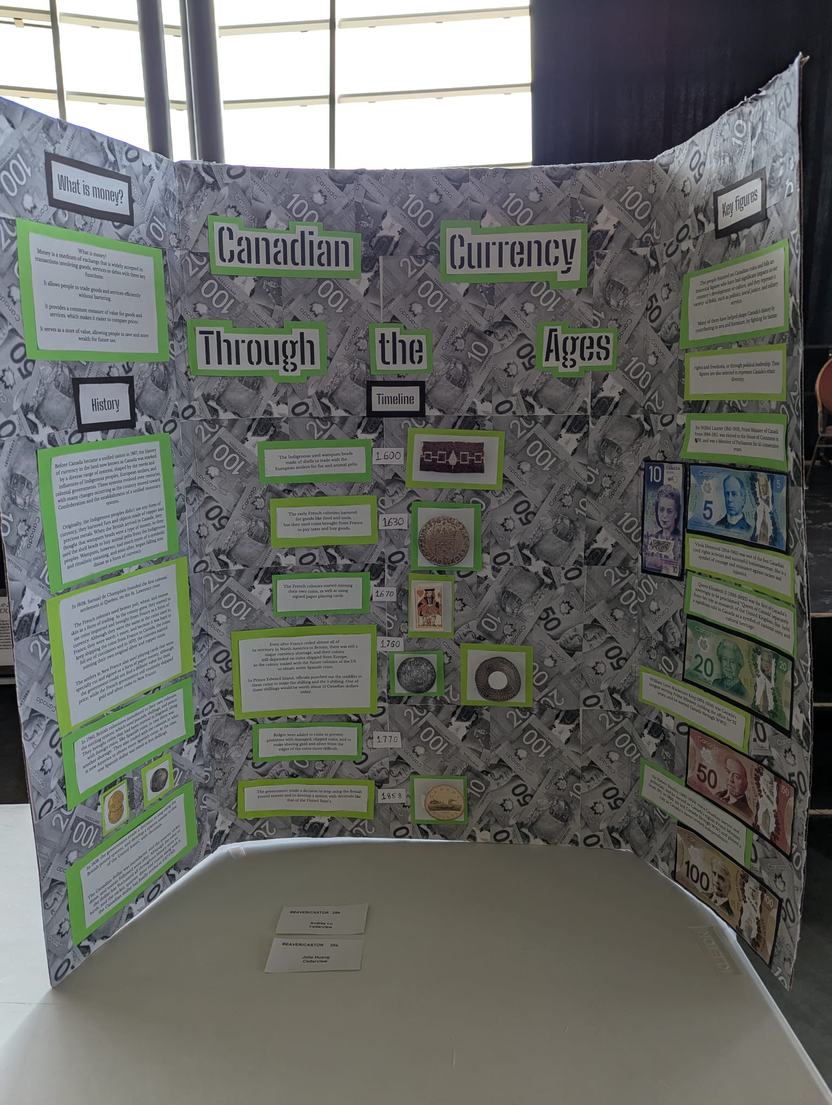

Slide 15
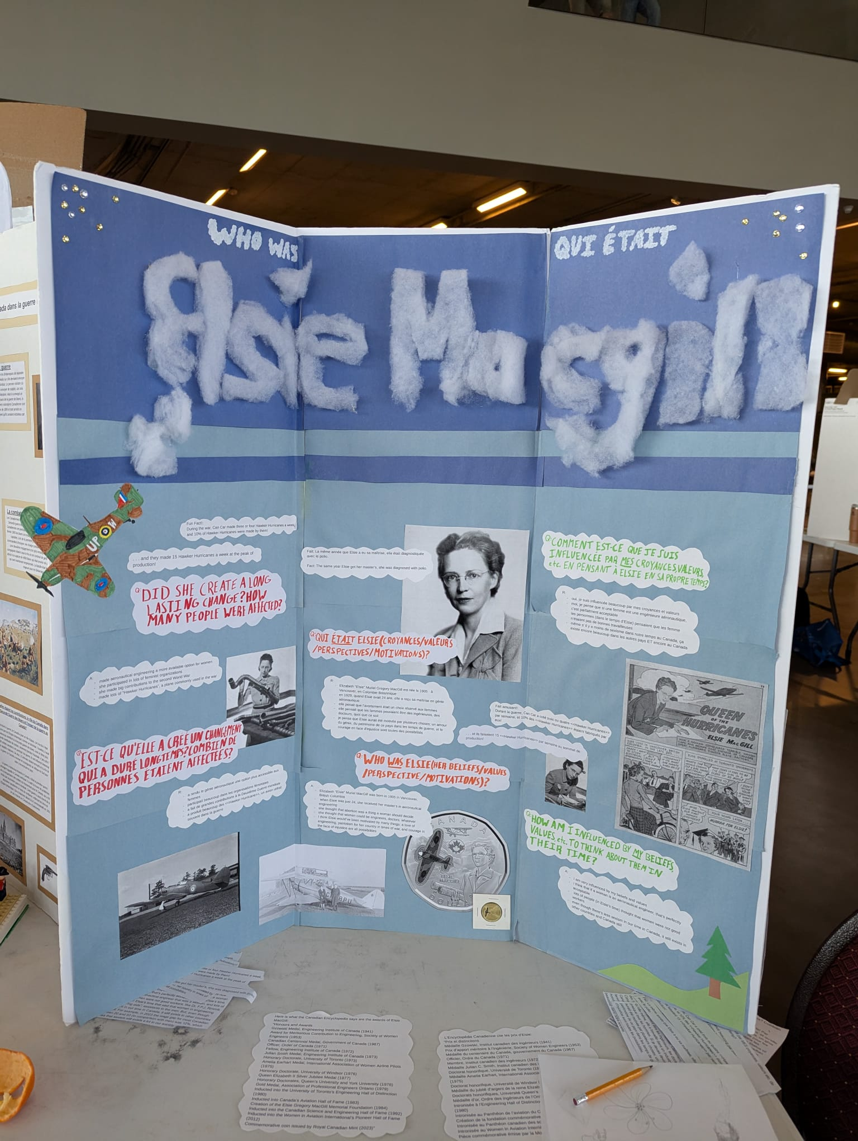
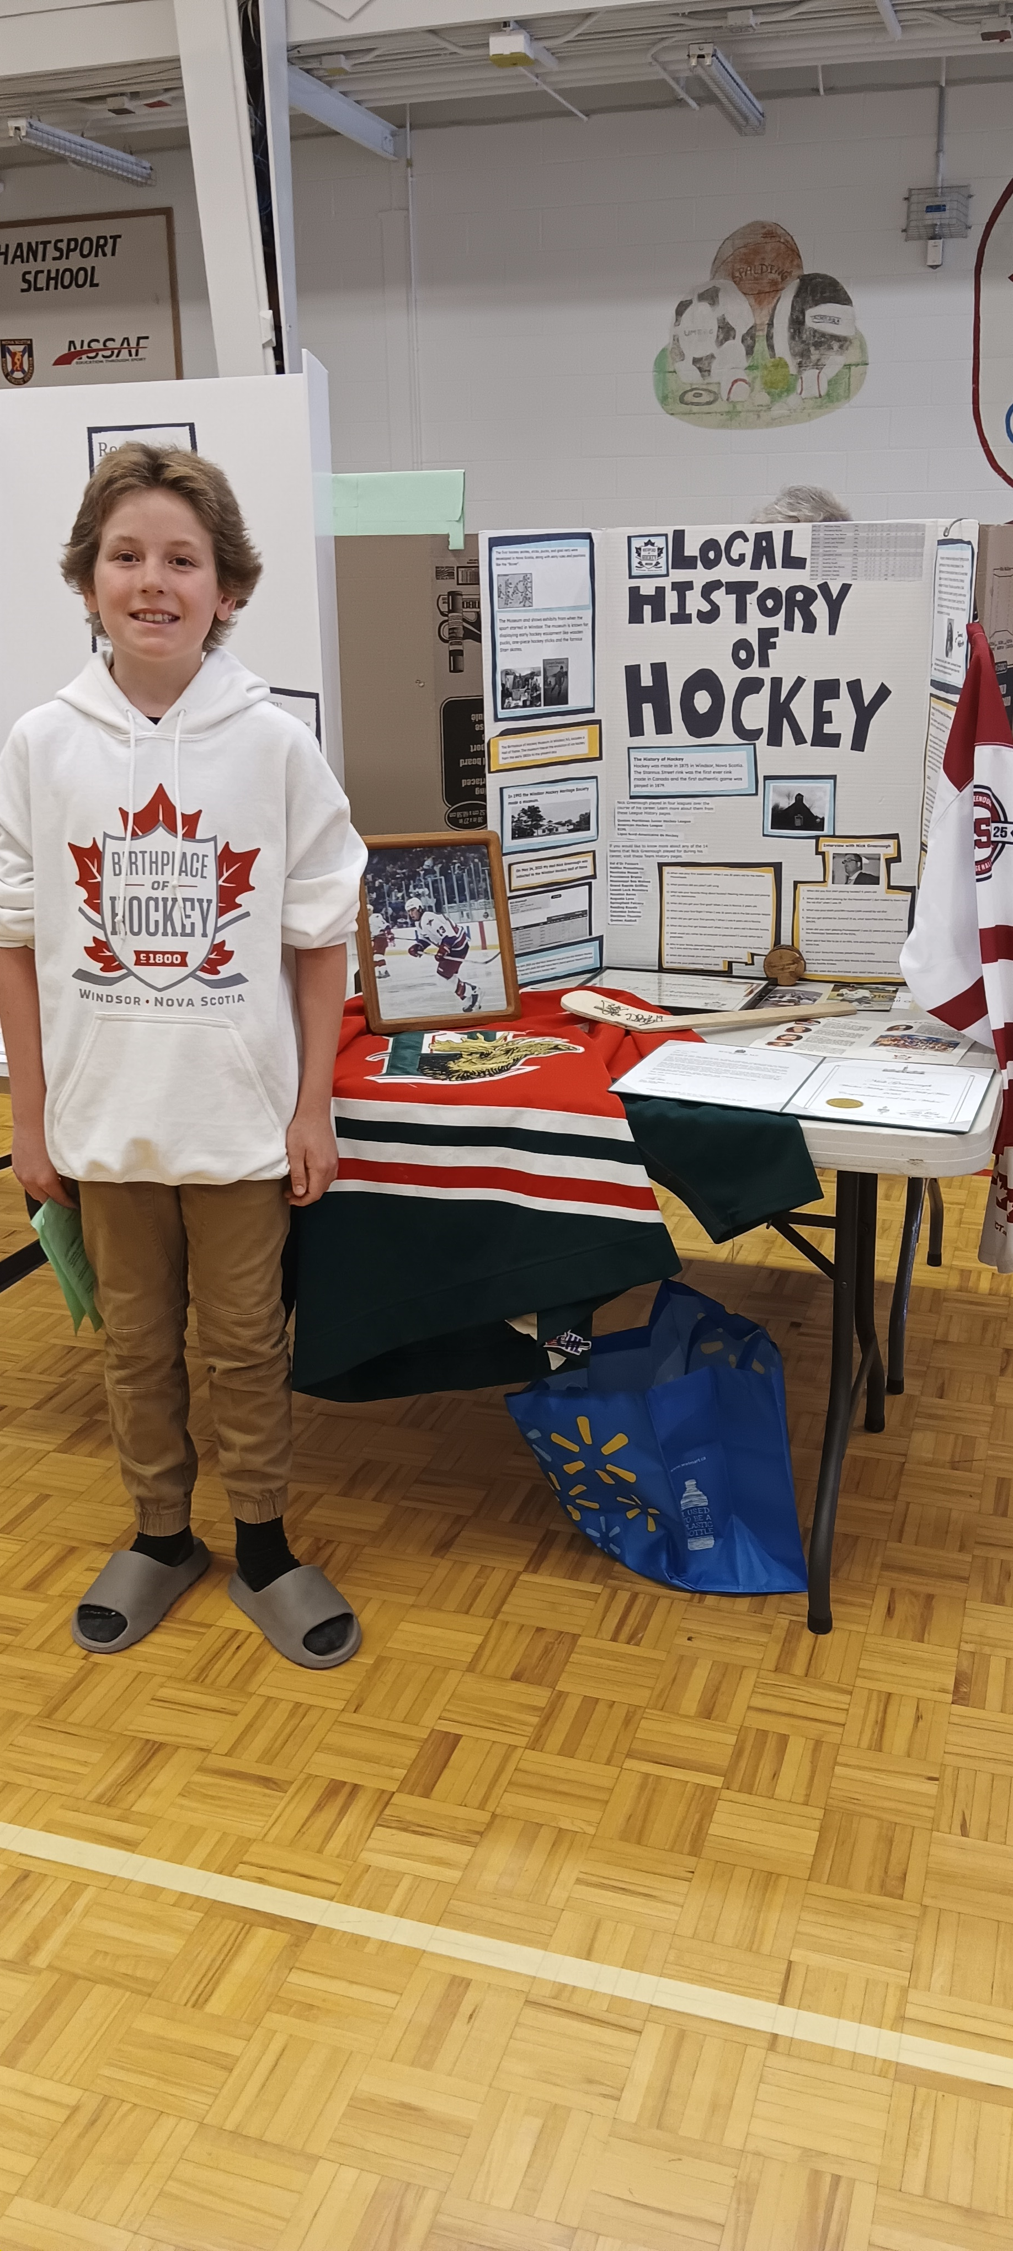

Slide 16
Making the Display Visually Engaging
A great display board combines text, visuals, and creativity. Visual elements make a display more engaging and help communicate information clearly.
Readable fonts and colors: A high-contrast color scheme (such as dark text on a light background) ensures readability. Avoid using overly decorative fonts that may be difficult to read.
Effective use of images: Photos, illustrations, maps, and diagrams bring a project to life. Each image should have a caption explaining its significance, such as "A traditional wooden spile used to tap maple trees."

Slide 17
Making the Display Visually Engaging
Headings and Subheadings – Large, bold titles and clear section labels will make the information easy to read. It is sometimes tempting to you fancy fonts, but it is more important that the audience can read them.
Neatness and clarity: Remind students to space out their sections evenly, use bullet points where appropriate, and align text and images neatly to maintain a professional appearance.
Colour and Design – Choosing a theme that reflects the topic can make the display visually appealing. However, it is important to maintain readability by using contrasting colors and avoiding clutter.

Slide 18
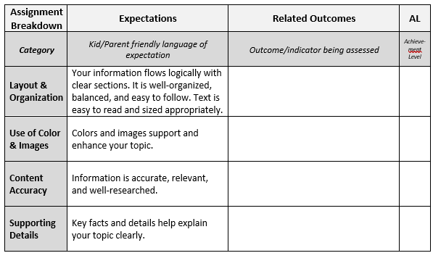
Heritage Fair Display Board Rubric

Slide 19
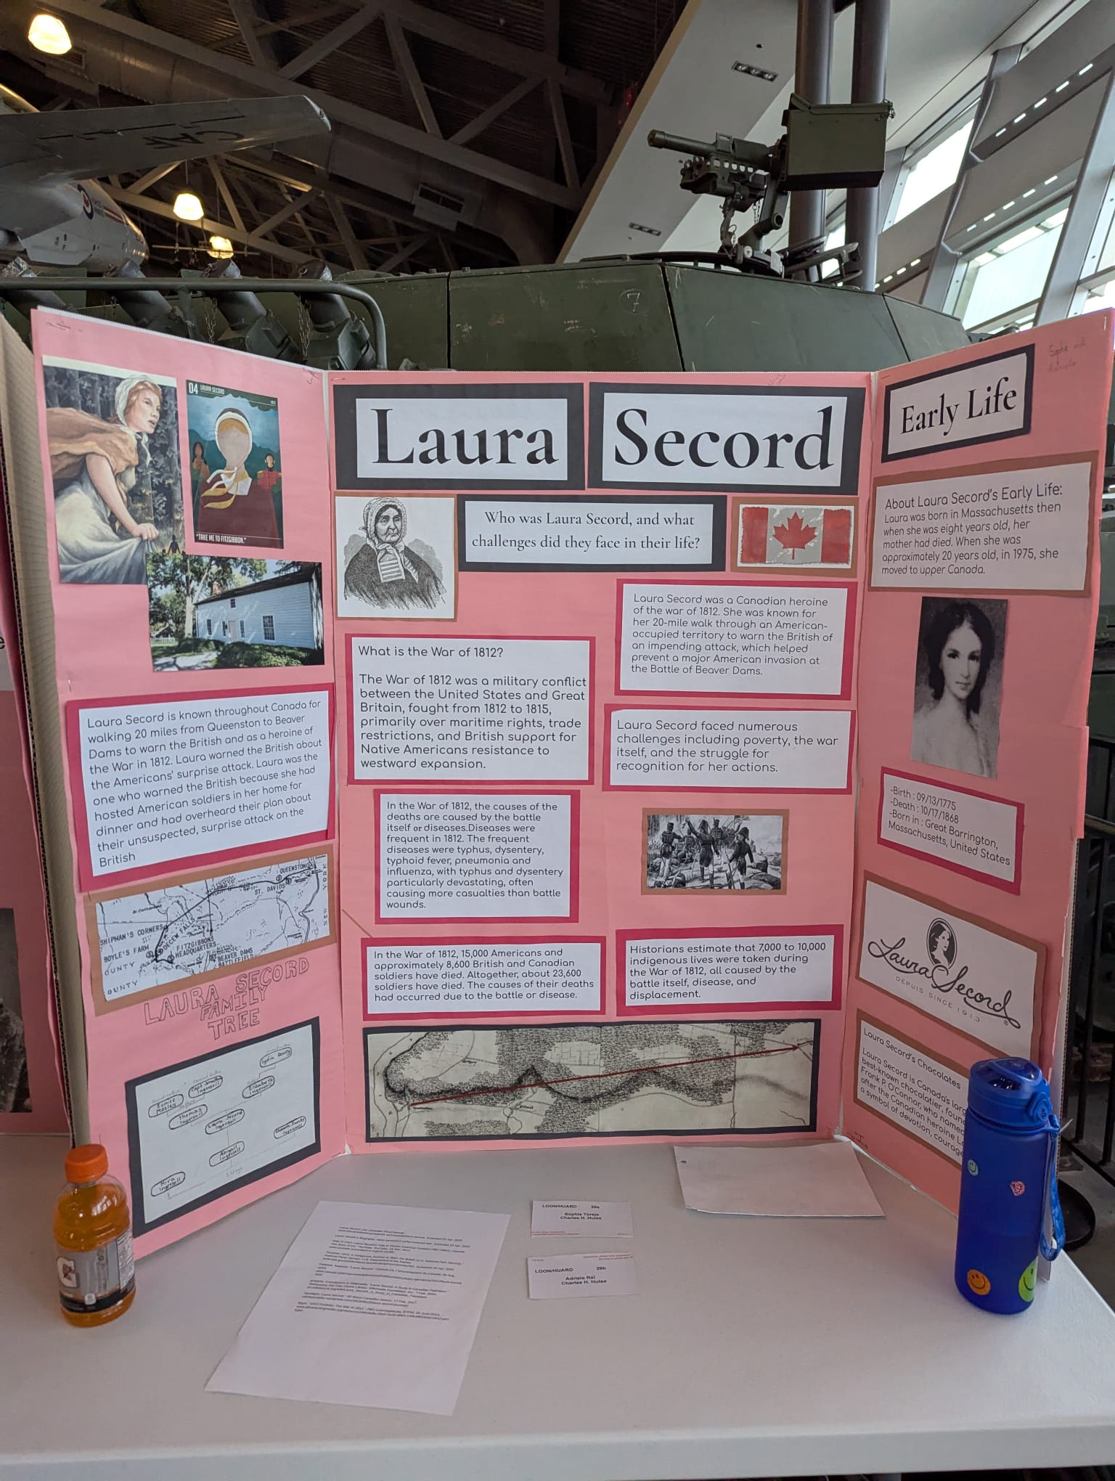
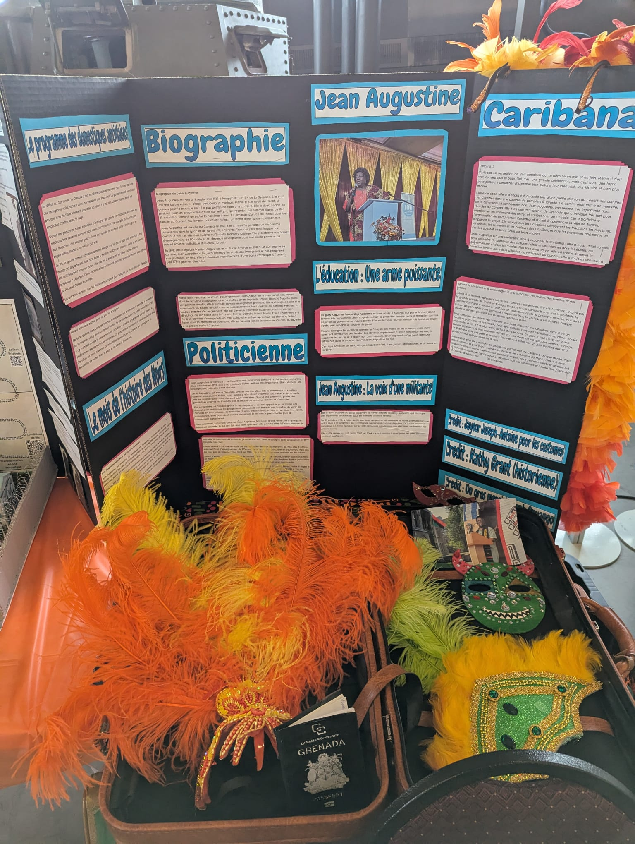

Slide 20
