Slide 1
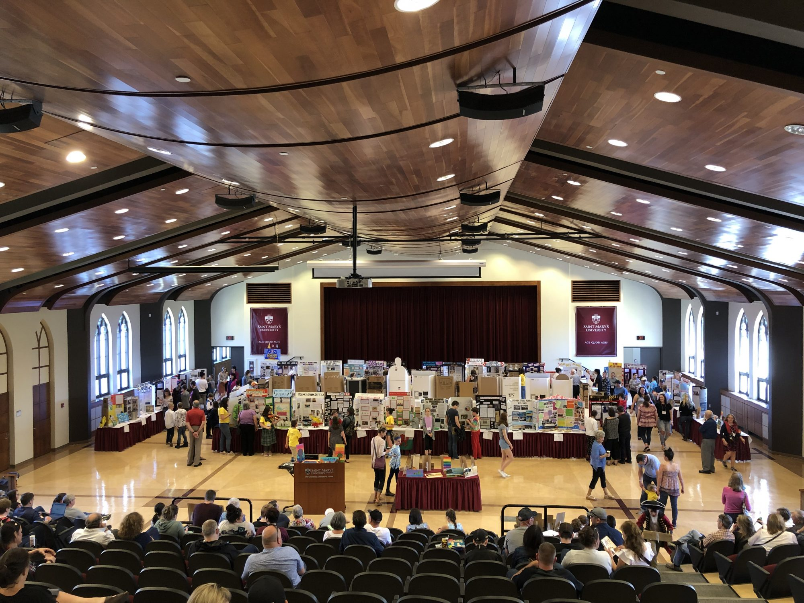
Heritage Fair: An Introduction
Exploring Canada’s History Through Student Projects
"Image courtesy of the Nova Scotia Provincial Heritage Fair. Used with permission."

Slide 2
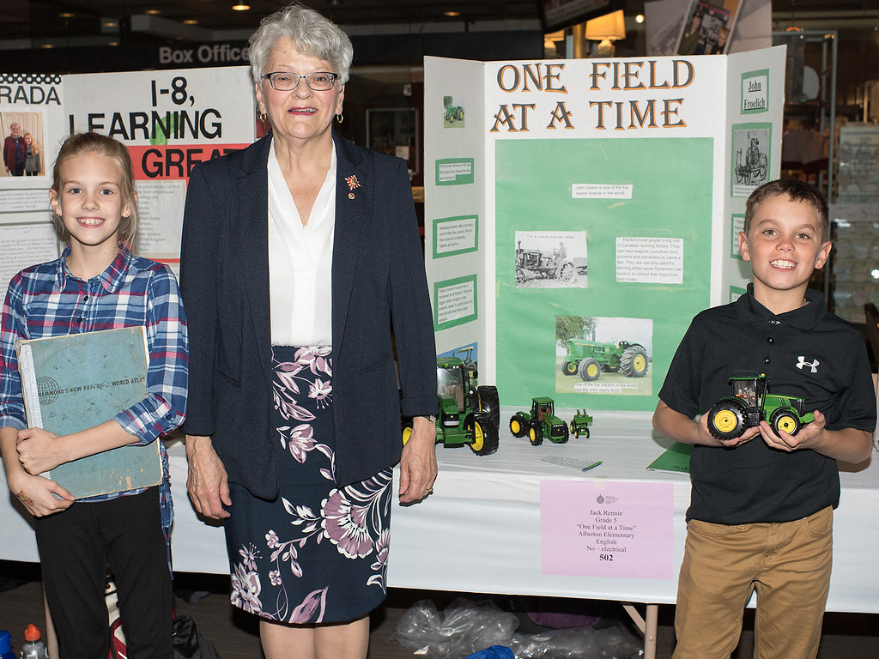
Introduction to Heritage Fairs
A Heritage Fair is a student-led project that explores topics related to Canadian history, heritage, culture, and diversity. It encourages students to discover stories from the past and present that have shaped Canada. Projects are presented to peers, teachers, parents, and community members at school and regional fairs.
"2018 Provincial Heritage Fair booths and medal winners" by Government of Prince Edward Island, licensed under CC BY 2.0, via Flickr.

Slide 3
Why Participate in a Heritage Fair?
Engage with History: Discover interesting facts and untold stories.
Develop Skills: Enhance research, critical thinking, and presentation skills.
Celebrate Diversity: Learn about different perspectives and cultures within Canada.
Have Fun! Creative freedom to express your findings through different formats.

Slide 4
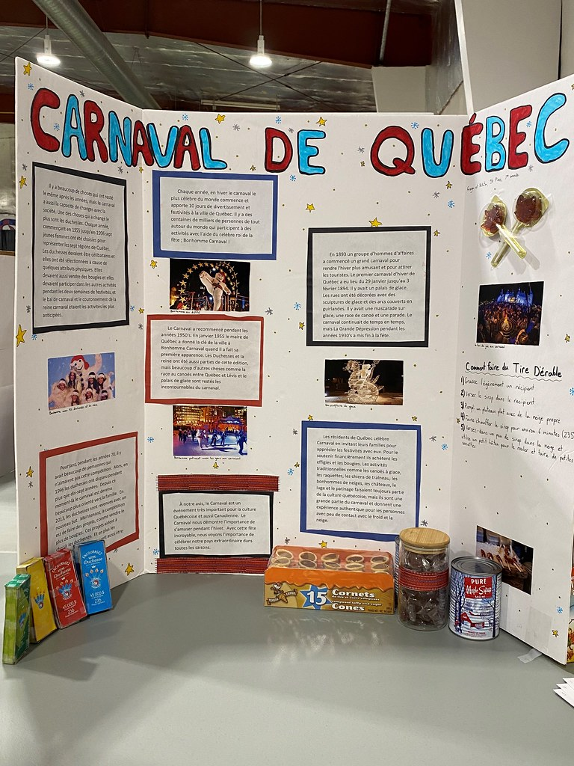
Types of Heritage
Fair Projects
Poster Boards: Visual displays with key facts and illustrations.
"Carnaval de Quebec (Freya Nostbakken & Nikita Smitas)" by Heritage Saskatchewan, licensed under CC BY 2.0, via Flickr.​

Slide 5
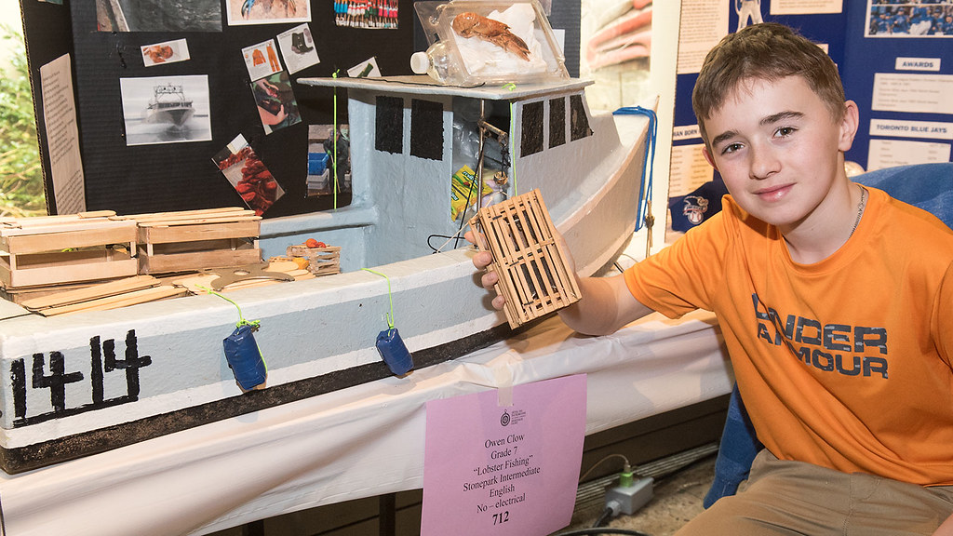
Types of Heritage Fair Projects
Models & Artifacts: 3D models, dioramas, or recreated artifacts.
"2018 Provincial Heritage Fair booths and medal winners" by Government of Prince Edward Island, licensed under CC BY 2.0, via Flickr.

Slide 6
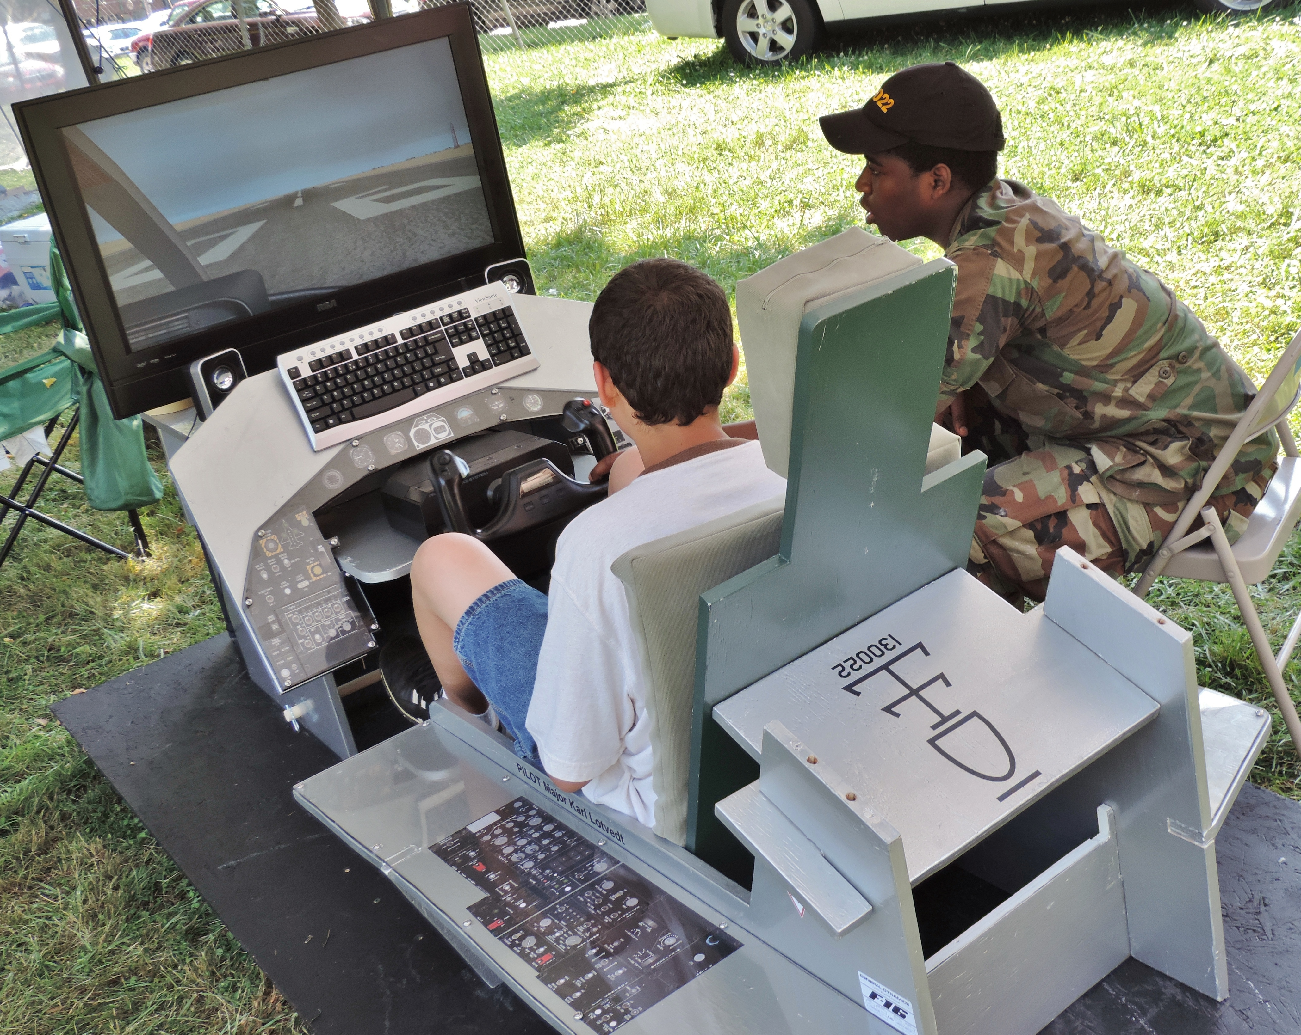
Types of Heritage Fair Projects
Digital Presentations: Slideshows, videos, or interactive websites.
“Flight simulator at the 2013 Dundalk Heritage Fair in Maryland” by Mdmetzger22 is licensed under CC BY-SA 3.0, via Wikimedia Commons.

Slide 7
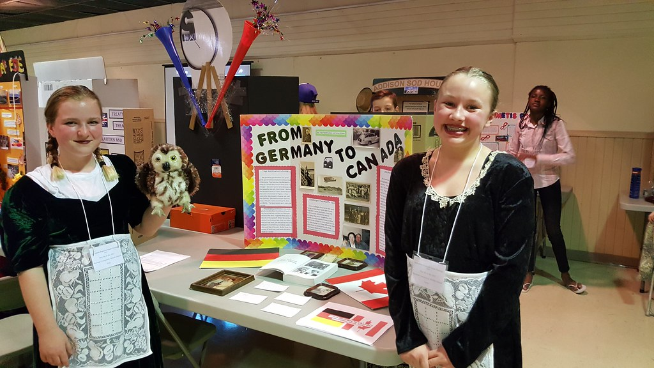
Types of Heritage Fair Projects
Performances: Skits, storytelling, or interviews to bring history to life.
"2017 Provincial Heritage Fair" by Government of Prince Edward Island, licensed under CC BY 2.0, via Flickr.

Slide 8
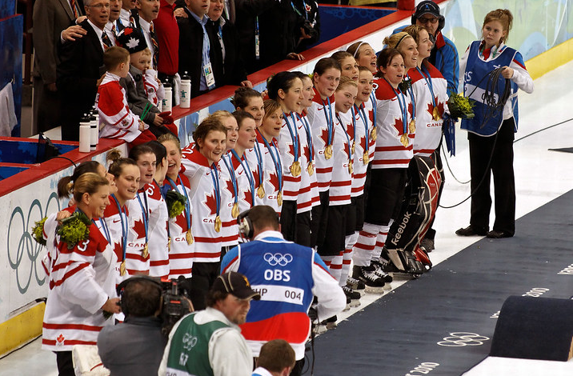
Choosing a Topic
Canadian History & Events: Explore important milestones and movements.
"Canada Women 2010 Winter Olympics" by s.yume, licensed under CC BY 2.0, via Flickr.

Slide 9
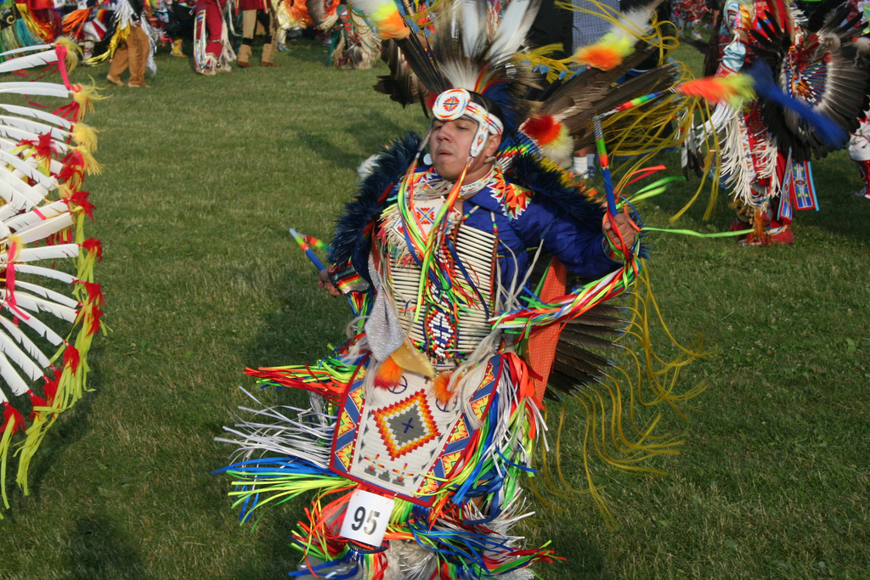
Choosing a Topic
Cultural Heritage: Highlight traditions, languages, and customs of various communities.
Image titled "Mi'kmaq," sourced from Wikimedia Commons. This image is in the public domain.

Slide 10
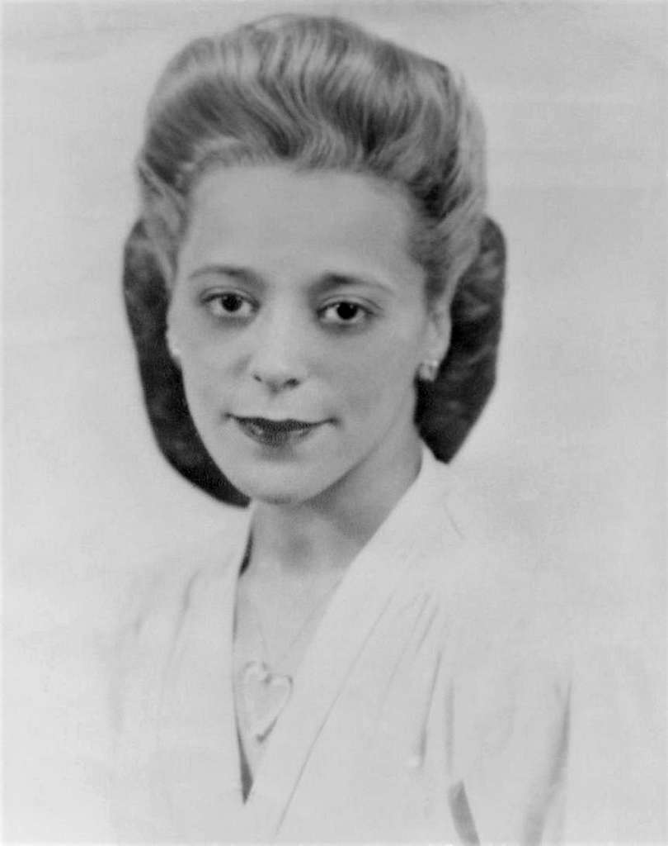
Choosing a Topic
Notable Individuals: Discover the contributions of historical figures.
Image of Viola Irene Desmond, sourced from PICRYL.
This image is in the public domain.​

Slide 11
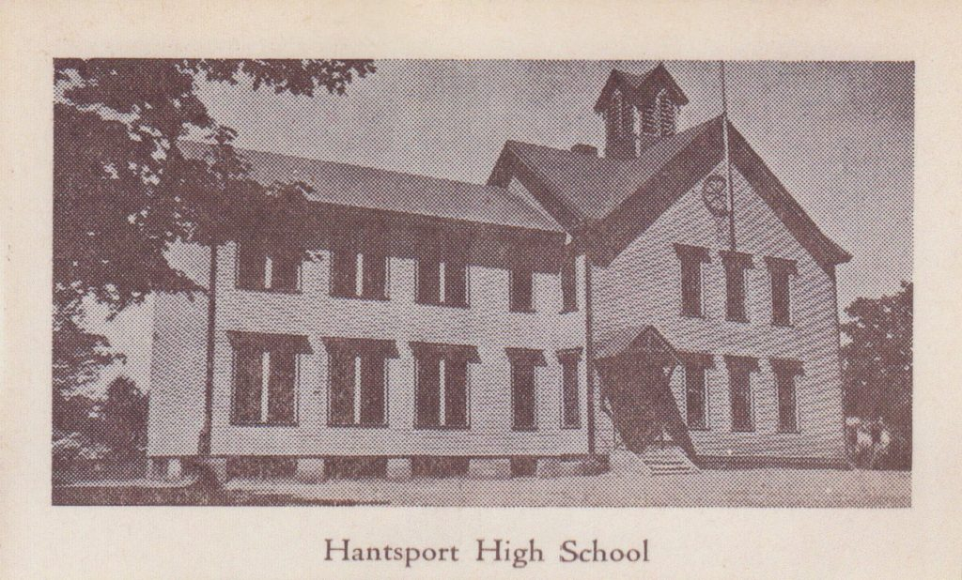
Choosing a Topic
Local History: Uncover stories from your own community.
"Hantsport School Addition" image courtesy of the Hantsport & Area Historical Society. Used with permission. McDade Heritage Centre.

Slide 12

Researching Your Topic
Start with Questions: What do I want to learn? Why is my topic important?
Use Reliable Sources: Books, websites, museums, and interviews.
Take Notes: Identify key information and avoid plagiarism.
"Office folders and books" by Vectorportal,
licensed under CC BY 4.0, via Vectorportal.​

Slide 13
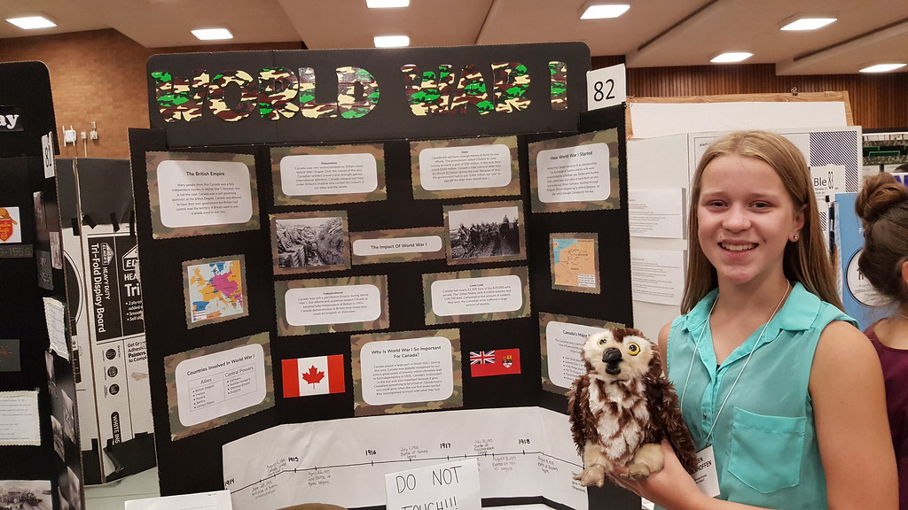
Creating Your Project
Organize Your Information: Create a clear and engaging narrative.
Add Visuals: Use pictures, maps, and diagrams to support your ideas.
Show Creativity: Design a project that reflects your personality and research style.
"2018 Provincial Heritage Fair" by Government of Prince Edward Island, licensed under CC BY 2.0, via Flickr.

Slide 14
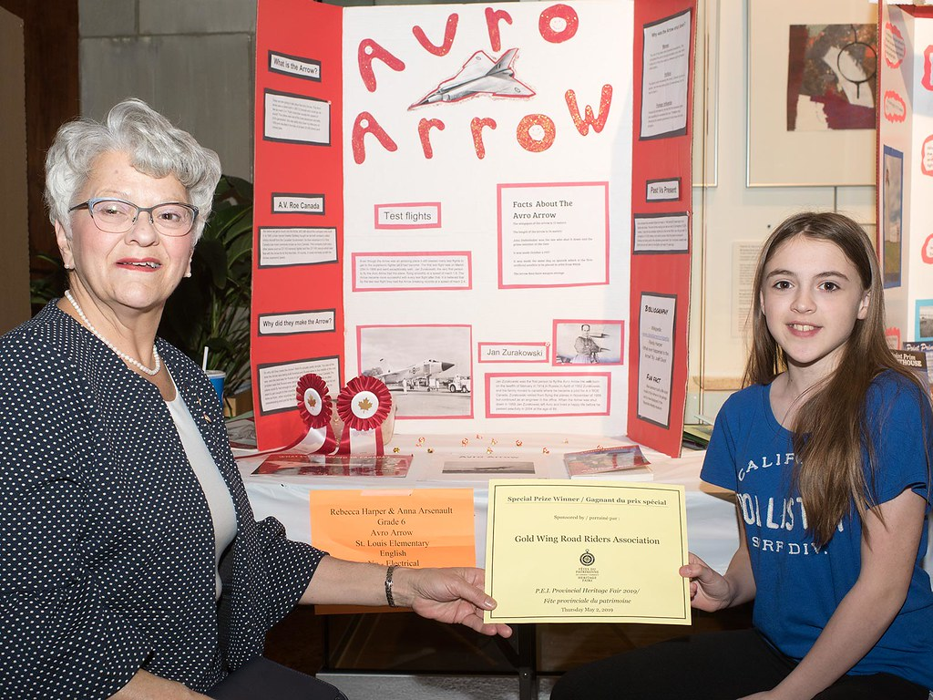
Presenting Your Project
Practice Speaking Clearly: Share your story with confidence.
Engage Your Audience: Make eye contact and invite questions.
Be Proud of Your Work: You’re showcasing your hard work and knowledge.
"2018 Provincial Heritage Fair" by Government of Prince Edward Island, licensed
under CC BY 2.0, via Flickr.

Slide 15
What Happens After?
School Fair: Present your project to classmates, teachers, and community.
Regional Fair: Exceptional projects move on to showcase at Regional Heritage Fairs.
Provincial Fair: Projects from the Regional Fair may move on to the Provincial Heritage Fair.
Recognition: Receive feedback, certificates, and maybe even awards!

Slide 16
Frequently Asked Questions
How long should my project be? Varies by format but aim for a 3-5 minute presentation.
Can I work in a group? Teacher dependent, partners are allowed at the provincial level.
Do I need to memorize everything? No, but knowing your topic well helps during Q&A.

Slide 17
Get Ready for Your Heritage Fair!
Final Tip
Have fun, explore your interests, and take pride in sharing your discoveries!

